Slide 1

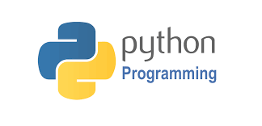

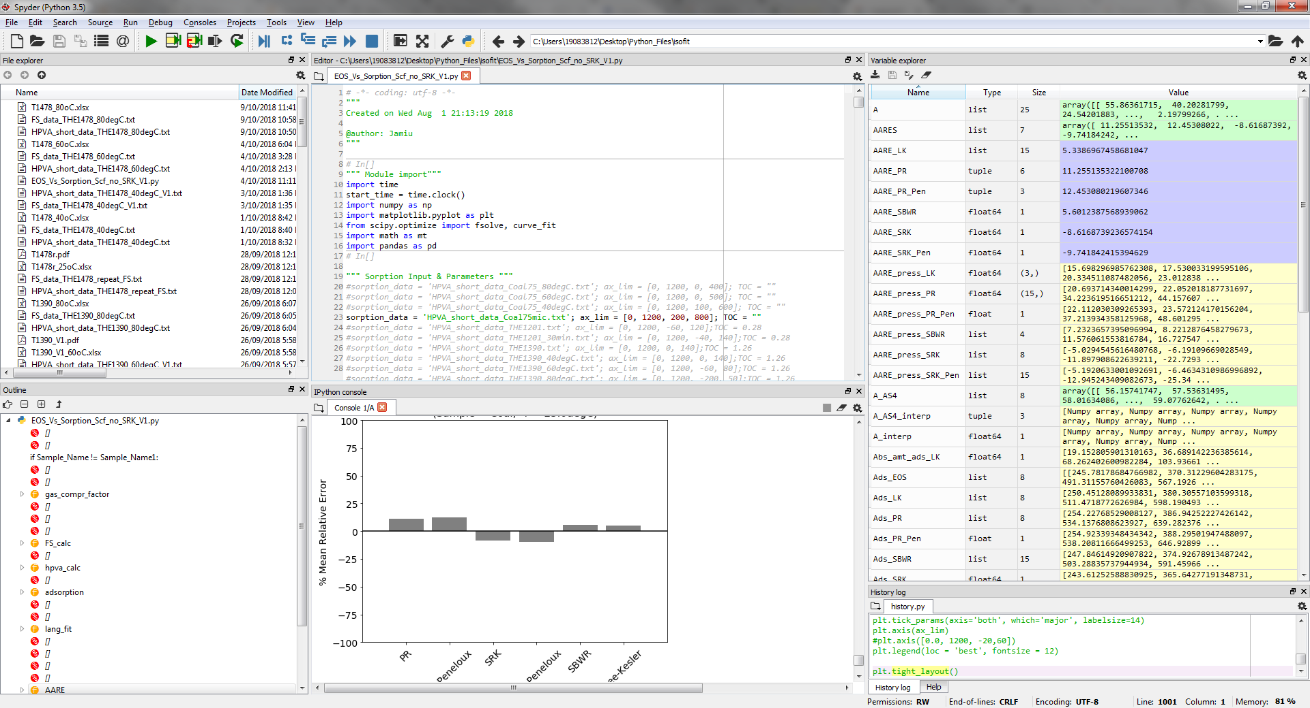
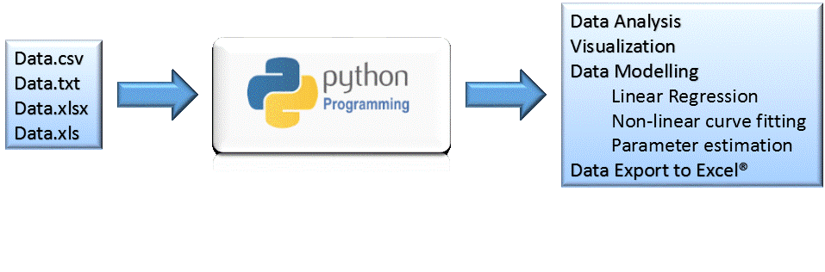
Python Crash Course
Research Data Analysis, Visualisation & Modelling with Python
Delivered
By
Jamiu M. Ekundayo
PhD Candidate Petroleum Eng. Dept. Curtin University

Slide 2
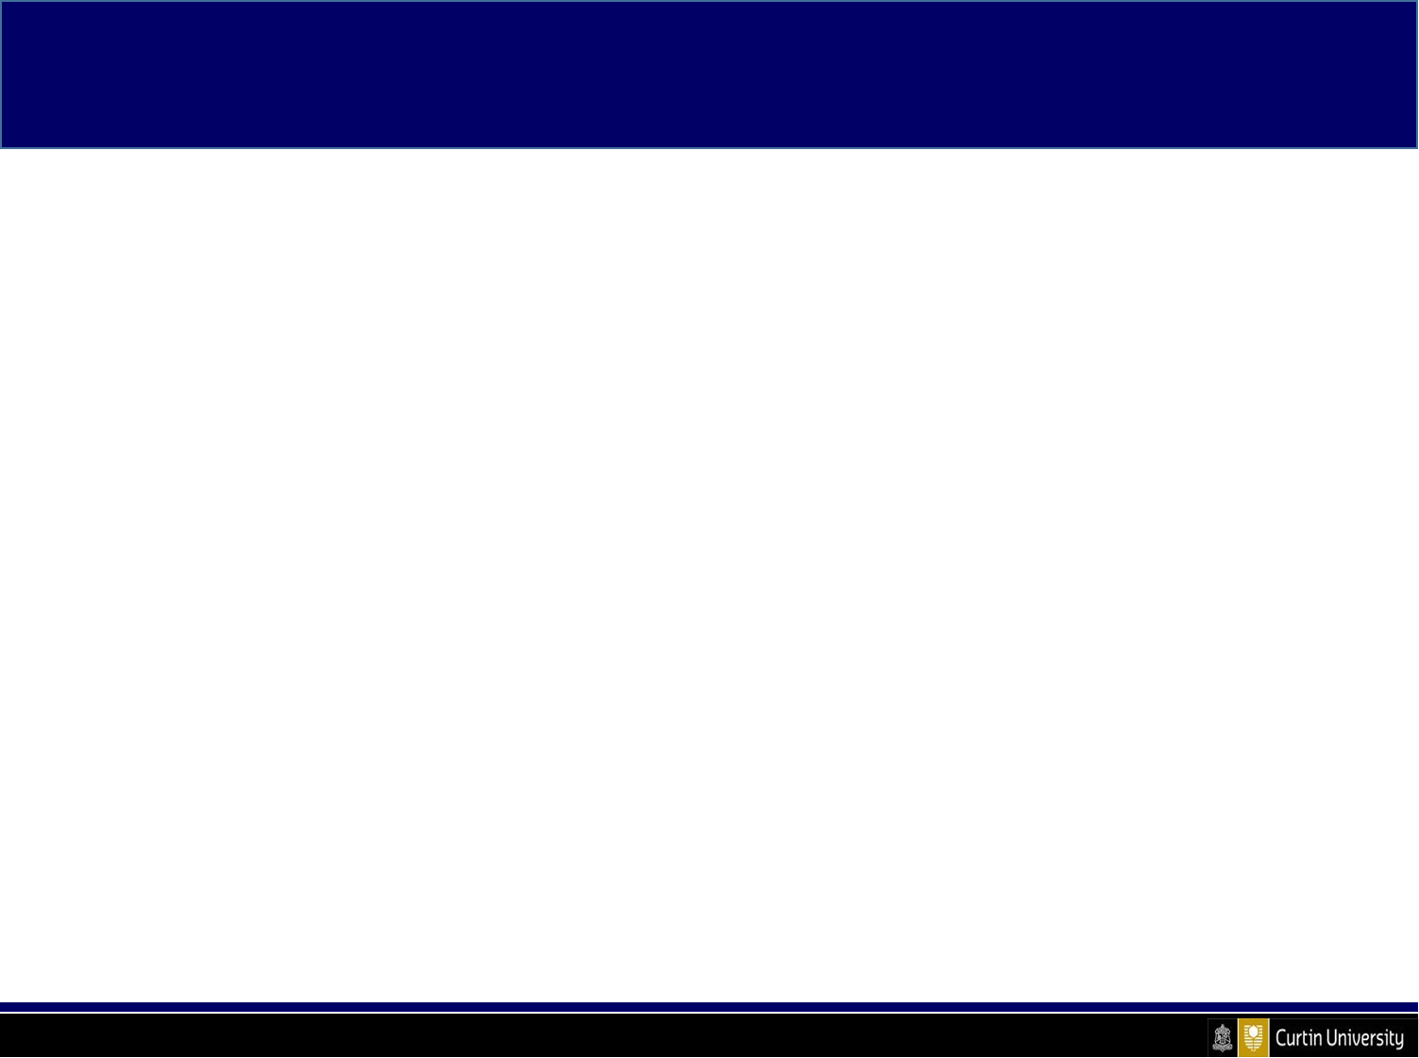
Learning Objectives
At the end of this workshop, participants should be able to:
Read input data from files (*.txt, *.csv, etc.)
Explore, visualize and analyse data
Perform data modelling (LSQ optimization, curve-fitting, parameter estimation, etc.)
Generate inputs for Excel®

Slide 3
Selected Projects
Project Name | Description | Expected Outcomes | Input Files
1. Text Analysis | Analysis of the Gettysburg Address by Abraham Lincoln in 1863 | Demonstrate the application of python basics, user-defined functions, visualisation, etc. | Abraham Lincoln.txt
2. Parameter Estimation | Estimation of the optimal parameters by curve-fitting (non-linear regression) some data to a function | In addition to the outcomes in project 1, this project will enable participants to demonstrate application of selected python modules to solving scientific problems. | project2_data.txt

Slide 4
Course Contents & Proposed Timing
Session 1 – 10.00am – 11.30am
Overview & Python basics
Operators, data types, variables & in-built functions
Working with conditions & loops
Functions (user-defined)
Data I/O (reading from & writing to files)
Working with modules
Data visualization
Session 2 – 11.30am – 12noon
Project 1 – Text analysis
Session 3 – 1.00pm – 3.00pm
Data Exploration & Modelling
Working with structured data
Linear & non-linear regressions
Curve-fitting and parameter estimation
Data Export to Excel®
Session 4 – 3.00pm – 4.00pm
Project 2 – parameter estimation

Slide 5
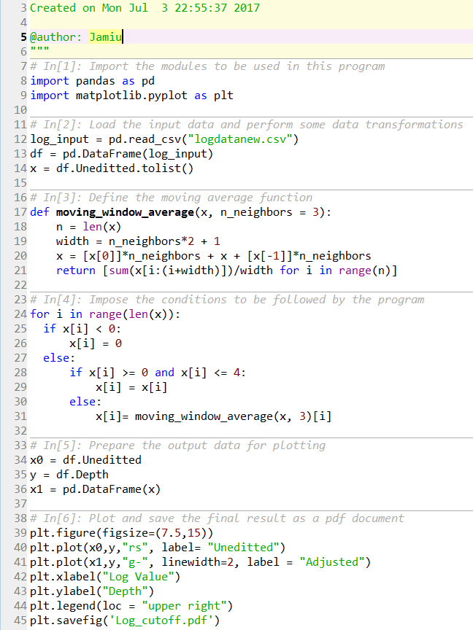
Sample Python Program

Slide 6
Session 1
Overview
&
Python Basics

Slide 7
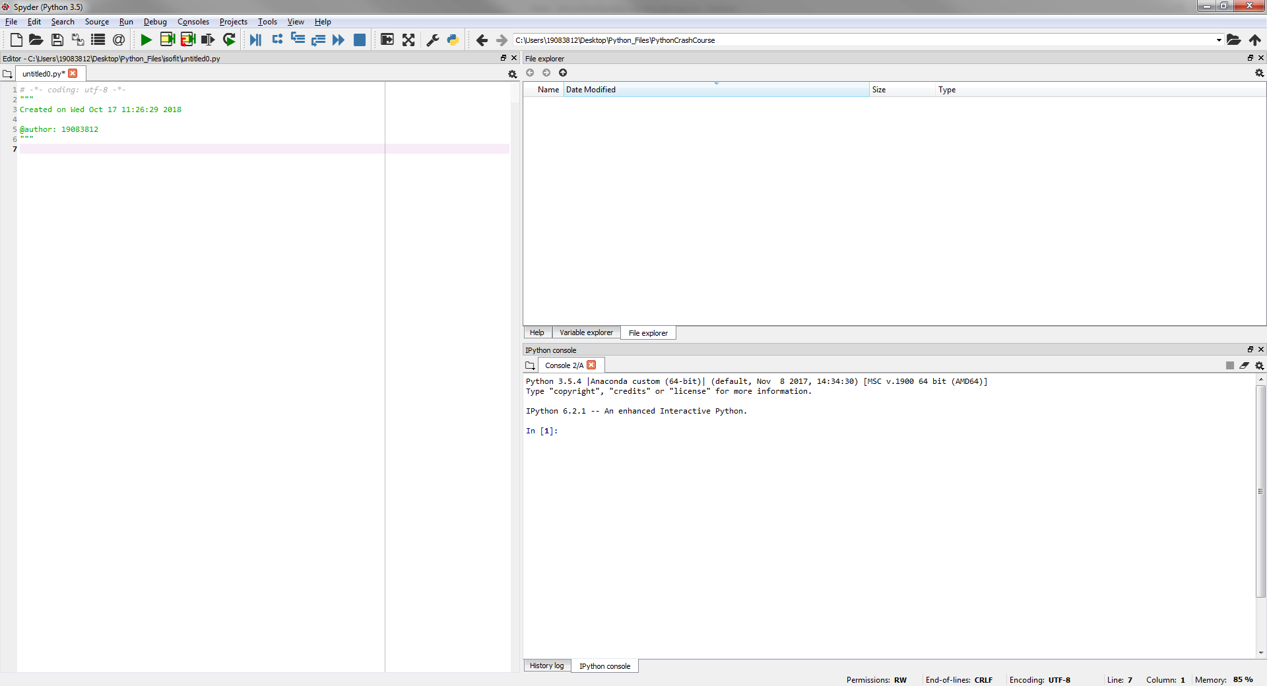
Spyder – Default Layout
3- Help / Explorers
1- Code Editor
3- Interpreter (console)
Python Crash Course: Session 1 – overview & python basics

Slide 8
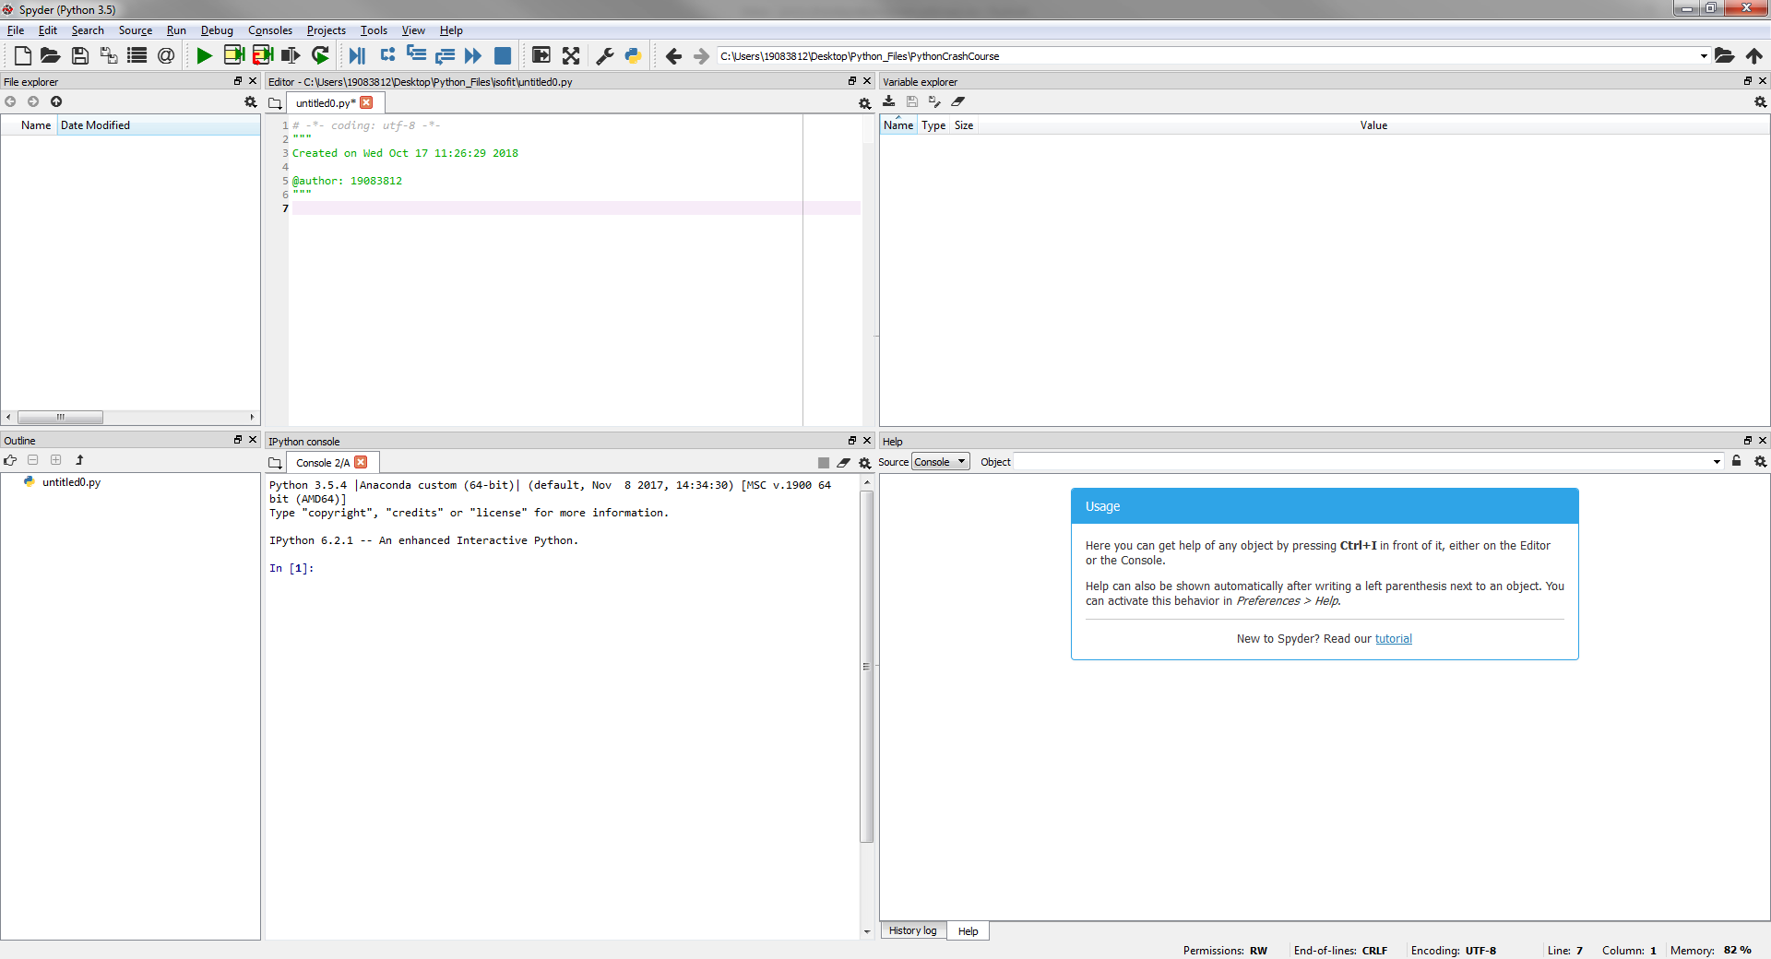
Spyder – Matlab Layout
1. File explorer
2. Code Editor
3. Variable Explorer
4. Outline
Displays the blocks and functions in your program
5. Interpreter
6. Help/ History log
Python Crash Course: Session 1 – overview & python basics

Slide 9
Menu Items
File Management Pane
Create new
Switch between files
Save files
Inspect files
Execution Pane
Run entire program
Run current code block
Run current code cell & proceed to next
Run selected codes
Re-run last file
Debugging Pane
Not used in this course
Preference Pane
Maximize/restore windows
Full-screen
Settings
Python Crash Course: Session 1 – overview & python basics

Slide 10
Python Operators
Operator | Description | Example
+ | Addition | 1 + 2 = 3
- | Subtraction | 2-1 = 1
* | Multiplication | 1*2 = 2
/ | Division | 1/2 = 0.5
** | Power | 3**2 = 9
// | Floor/Integer division | 1//2 = 0
% | Modulus/remainder | 1%2 = 1
_ | Underscore* (Returns the last object called by python)
| | Boolean operator (OR) (Returns ‘TRUE’ if 1 of 2 or more expressions is true) | (1 < 2) | (3 < 2) = True
& | Boolean operator (AND) (Returns ‘TRUE’ if all of 2 or more expressions are true) | (1 < 2) & (3 < 2) = False
! | Boolean operator (NOT) (Returns the negation of sets) | 1 != 2
* Only available in the interactive mode
NOTE:
Python follows the mathematical order of precedence – i.e. order of evaluating an expression
Python Crash Course: Session 1 – overview & python basics

Slide 11
Python Operators
Just for fun! Type & run this expression in your IPython Console:
5*2+3**2-1/2%3//4
Can you figure out how Python arrived at 19.0?
Try!
5*2+3**2-1/(2%3)//4
Is the result 19.0?
The message here is:
Using parenthesis (brackets) can save you from unforeseen computation errors
Python Crash Course: Session 1 – overview & python basics

Slide 12
Python Data-Types, in-built functions and Variables
Data Types in python: Important to know how python stores an object
Type | Example | Function equivalent
String | “5.0”, “I am a string” | str() e.g. str(’25’)
Integer | 5 | int() e.g. int(5.75)
Floats | 5.0 | float() e.g. float(3.67)
Complex | 1 + 2j | complex() e.g. complex(-2, 5)
Variables and their Naming Rules
A variable is string to which an expression is assigned e.g. my_var = 1 + 2
A variable can:
Only contain one word (no space between letters)
Only use letters, numbers and underscore
Not begin with a number
Python Crash Course: Session 1 – overview & python basics

Slide 13
Python Data-Types, in-built functions and Variables
Common String Operations: Some interesting things you can do with strings
Let’s say will have a string called my_string = ‘What is in a Name?’
Operation | Description | Example
len(string) | Returns the number of characters in a string | len(my_string)
string.split( sep = “ ”) | Returns a list of each item in the string separated by space (or any other specified separator) | my_string.split( )
string.replace(old, new) | Returns a new string with the specified item replaced | my_string.replace(‘is’, ‘is not’)
+ | Concatenates a specified number of strings | my_string.replace('?', " ") + 'other than letters?'
string[start:stop:step] This is called slicing | Returns a string of characters in the positions start to stop in specified steps | my_string[5:10] my_string[5:10:2]
string[::-1] | Used to reverse a string | my_string[::-1]
You can learn more interactively on this website:
https://www.learnpython.org/en/Basic_String_Operations
Python Crash Course: Session 1 – overview & python basics

Slide 14
Python Data-Types, in-built functions and Variables
Formatting Strings: Particularly useful when floats are being converted to strings for reporting
Format | Description | Example
%s format(input, ‘s’) | Used for strings (texts) | "The first five characters are '%s'" % my_string[:5]
%d format(input, ‘d’) | Used to format integers as strings | 'My string is %d long.' % len(my_string) 'My string is '+ format(len(my_string), 'd') + ' long.'
%f format(input, ‘f’) | Used to format floats as strings | 'pi = %f' % (22/7) 'pi = ' + format(22/7, 'f')
%.<integer>f format(input, ‘.<integer>f’) | Used to format a float as a string with a specified number of decimal places | 'pi = %.4f' % (22/7) 'pi = ' + format(22/7, '.4f')
Try this!
'A=%.3f, B=%.3f, C=%.3f, D=%.3f' % tuple(numpy.random.randn(4))
Python Crash Course: Session 1 – overview & python basics

Slide 15
Python Data-Types, in-built functions and Variables
Indexing/Slicing
Indexing in python starts from 0 and is usually left-to-right although right-to-left indexing is also supported
Try these:
My_string = “exploring”
My_string[8]
My_string[-1]
0 | 1 | 2 | 3 | 4 | 5 | 6 | 7 | 8
e | x | p | l | o | r | i | n | g
-8 | -7 | -6 | -6 | -5 | -4 | -3 | -2 | -1
Python Crash Course: Session 1 – overview & python basics

Slide 16
Python Data-Types, in-built functions and Variables
Lists, Tuples & Sets: Sequences of objects of different types
Examples:
My_list = [1, 2, ‘a’, ‘b’, ‘c’]
My_tuple = tuple(My_list)
My_set = set(My_list)
Mutability & ‘hashability’? Try the following in your ipython console:
My_list.append(‘5’) My_list[3]
My_tuple.add(‘5’) My_tuple[3]
My_set.add(‘5’) My_set[3]
Lists are mutable & hashable, tuples are immutable but hashable while sets are mutable (unless frozen) but not hashable
Try these:
My_froset = frozenset(My_list)
My_froset.add(‘5’)
Python Crash Course: Session 1 – overview & python basics

Slide 17
Python Data-Types, in-built functions and Variables
Range (range(start, stop, step)): Immutable sequence of integers.
Examples:
range(5)
range(0, len(my_list), 2)
Python Operations/methods with Lists, Tuples and Sets: To find out what you can do with any of these items, simply type help(item) in your console
Item | Common Operations/Methods
List | List.append( ), List.reverse( ), List.remove( ), List.clear( ), List.remove( ), etc.
Tuple | Tuple.count( ), Tuple.index( )
Set | Set.add( ), Set.remove( ), Set.update( ), Set.copy( ), etc.
Examples: mylist_new = list(range(0, 10, 2))
mylist_new.append(6)
tuple(mylist_new).count(6)
Python Crash Course: Session 1 – overview & python basics

Slide 18
Python Data-Types, in-built functions and Variables
Dictionary: Unordered sequence of mutable objects
A dictionary has two main attributes namely keys and values. A dictionary is actually formed by mapping the elements of values to the corresponding elements of keys.
For example:
Name = ['Lukman', 'Partha', 'Jimmy', 'Yujie', 'Aja’]; Age = [50, 25, 32, 23, 24]
Dictionary_1= dict(zip(Name, Age))
Some dictionary methods includes
Dictionary_1.key( )
Dictionary_1.values( )
Dictionary_1.update({“Jie”: 27})
Dictionary_1[“Xiu”] = 31
Dictionary_1.pop[“Xiu”]
Dictionary_1[“Lukman”] +=15
Python Crash Course: Session 1 – overview & python basics

Slide 19
Working with conditions & loops
“if-elif-else” keywords are used for conditional expressions in python.
if condition1:
expression1
elif condition2:
expression2
:
:
else:
alternative expression
Loops are used for repetitive or iterative operations.
Such operations are performed using “for … in…” or “while” keywords in python
For example:
Python Crash Course: Session 1 – overview & python basics

Slide 20
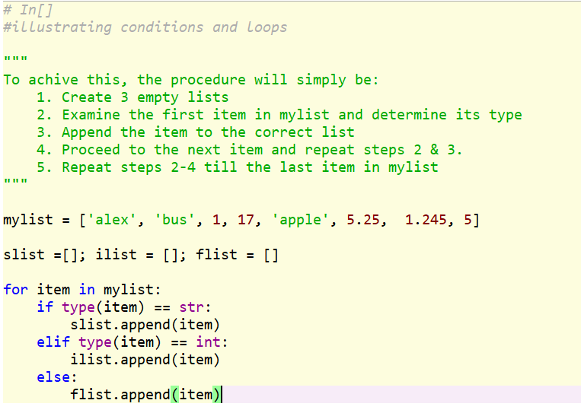
Working with conditions & loops – List Comprehension
Python Crash Course: Session 1 – overview & python basics

Slide 21
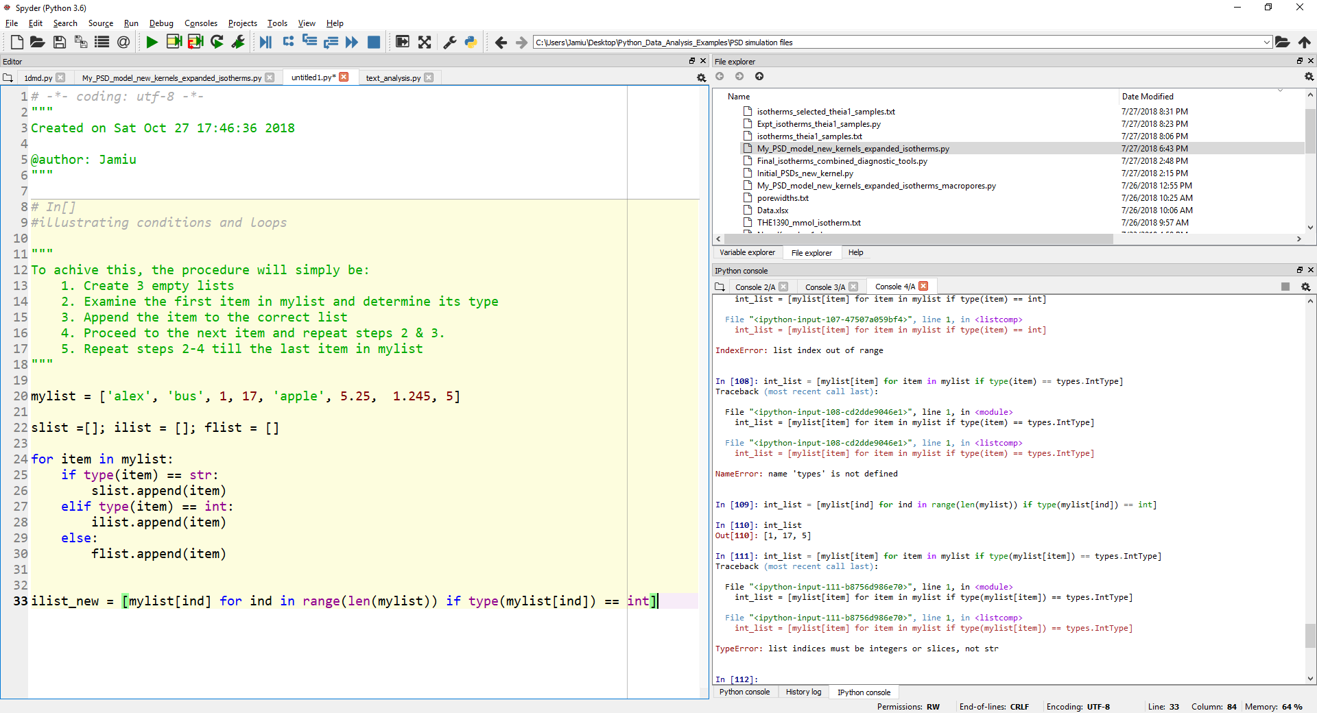
List Comprehension
Assuming the last example actually requires only a list of integers. We simply can do this:
This is known as list comprehension. It helps you achieve efficient codes and shorter run times
A list comprehension is made up of the following components:
Output expression (mylist[ind])
Variable (ind)
Input sequence (range(len(mylist)))
Optional predicate (if type(mylist[ind]) == int)
Python Crash Course: Session 1 – overview & python basics

Slide 22
Functions (user-defined)
A function is a block of codes that can be called to perform some task(s)
The general syntax for user-defined functions in python is:
def function_name(parameters):
“”” comments “””
expression
return(object)
A function can be called by typing its name and specifying the parameters (if any)
For example: Var1 = function_name(parameters)
Python Crash Course: Session 1 – overview & python basics

Slide 23
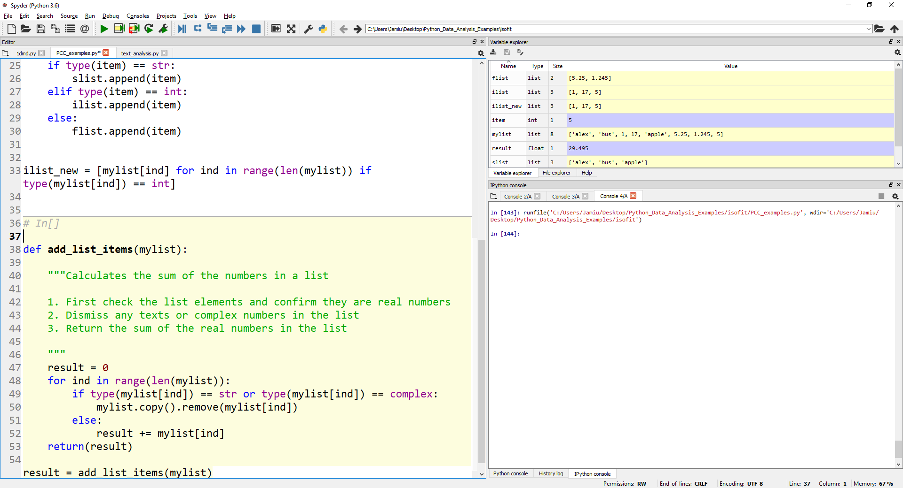
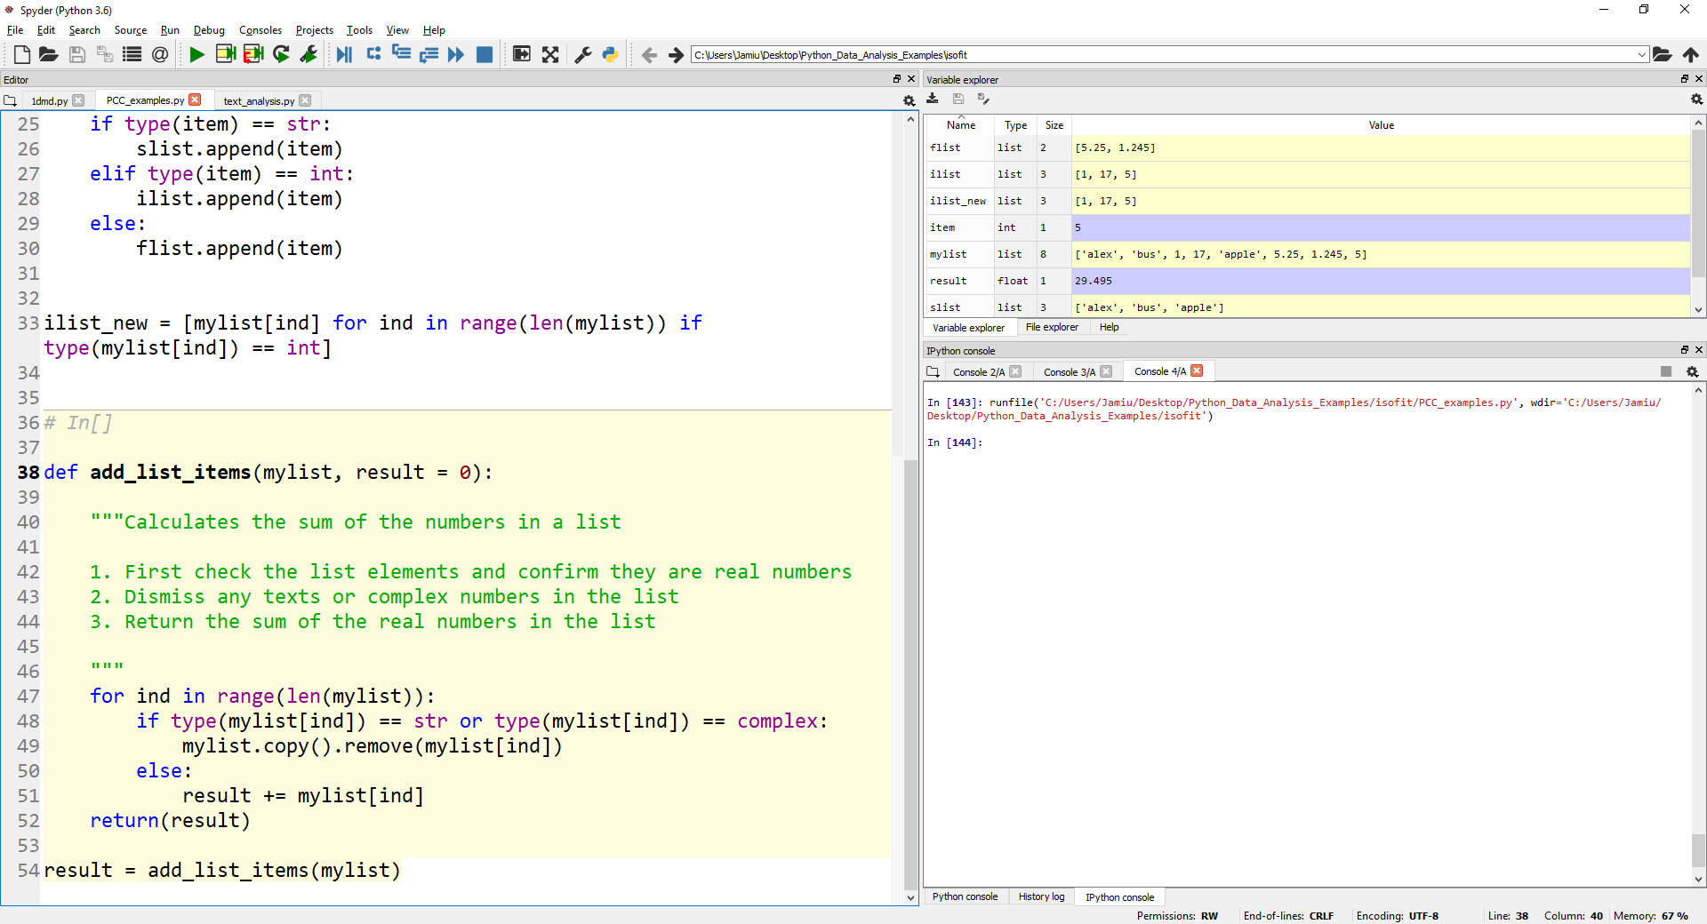
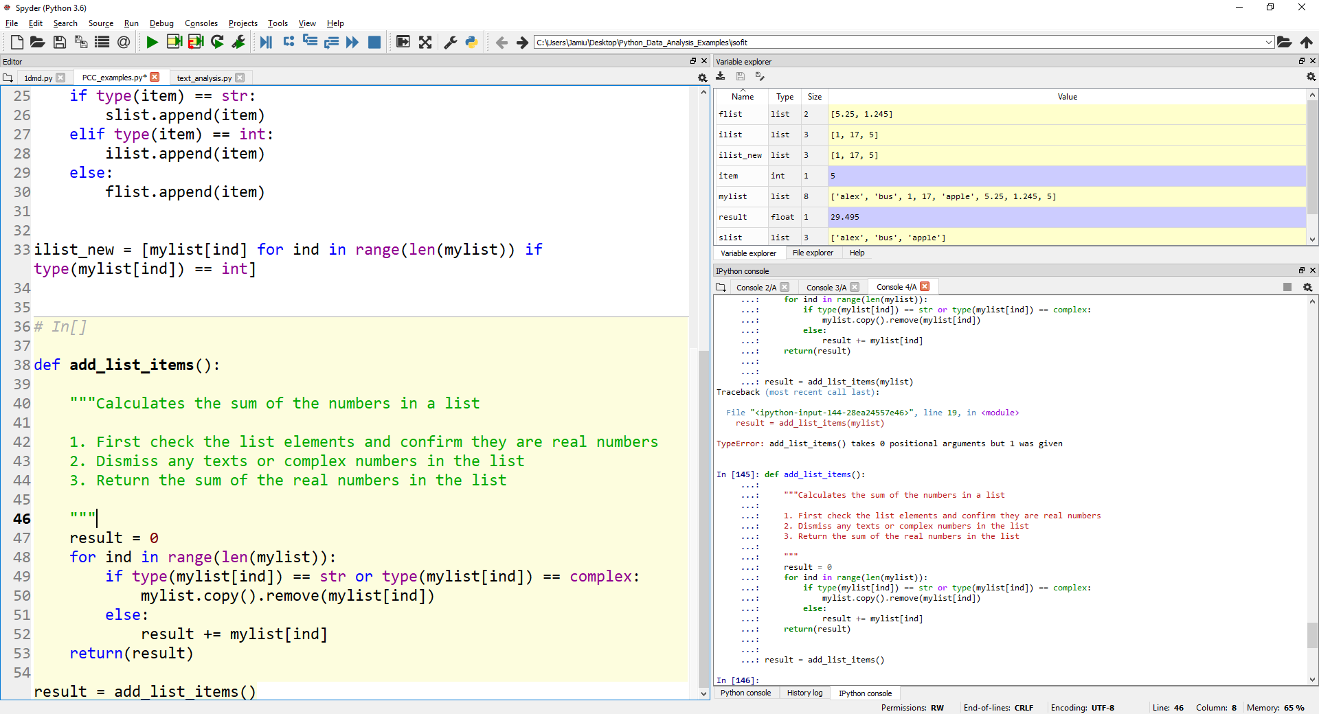
Functions (user-defined)
Python Crash Course: Session 1 – overview & python basics

Slide 24
Data Input/Output (reading from & writing to files)
User input can be obtained using the input( ) function
e.g. myname = input( )
To write data to the screen, the function print( ) is used.
e.g. print(‘My name is %s’ % myname)
To open file, use the function open(filename, ‘r’/’w’)
Alternatively, use with open(filename, ‘r’/’w’) as name:
To read data from an open file, use*:
name.read( ) to read the entire content of the file as a string
name.readline( ) to read a single line (usually the first line)
name.readlines( ) to read the file line by line and returns a list of strings
To write data to a file, the name.write(“specify what to write here” ) is used
* Care should be taken in using both read & readline(s) together on the same file
Python Crash Course: Session 1 – overview & python basics

Slide 25
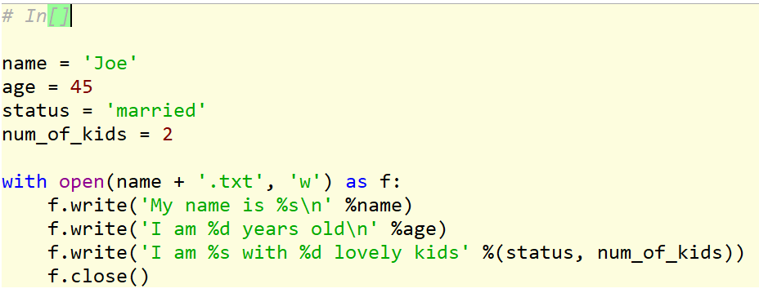
Data Input/Output (reading from & writing to files)
Try the following:
file = open('Mary_Lamb.txt', 'r')
file_content = file.read( )
line1 = file.readline( )
lines = file.readlines( )
Python Crash Course: Session 1 – overview & python basics

Slide 26
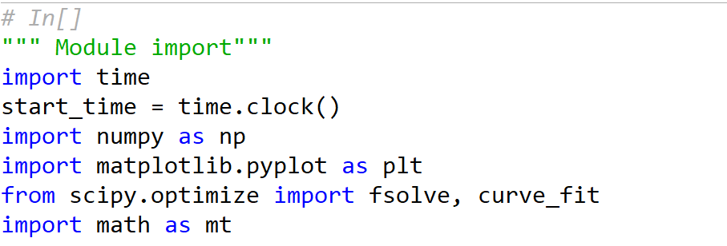
Working with modules
A module is a file containing python definitions and statements that can be deployed to achieve desired results
Modules are files with extension .py
A module must be imported prior to use. To import, use the following syntax:
import module_name => This is known as absolute import
from module_name import ABC, XYZ => This is known as relative import
Python Crash Course: Session 1 – overview & python basics

Slide 27
Plotting
Most commonly used plotting module in python is matplotlib.pyplot
To use, simply import matplotlib.pyplot as plt
There are several plot options available in matplotlib.pyplot
Examples are:
Line plots => plt.plot( )
Scatters => plt.scatter( )
Histograms => plt.bar( )
A complete of different plot options are available on https://matplotlib.org/api/_as_gen/matplotlib.pyplot.html
Python Crash Course: Session 1 – overview & python basics

Slide 28
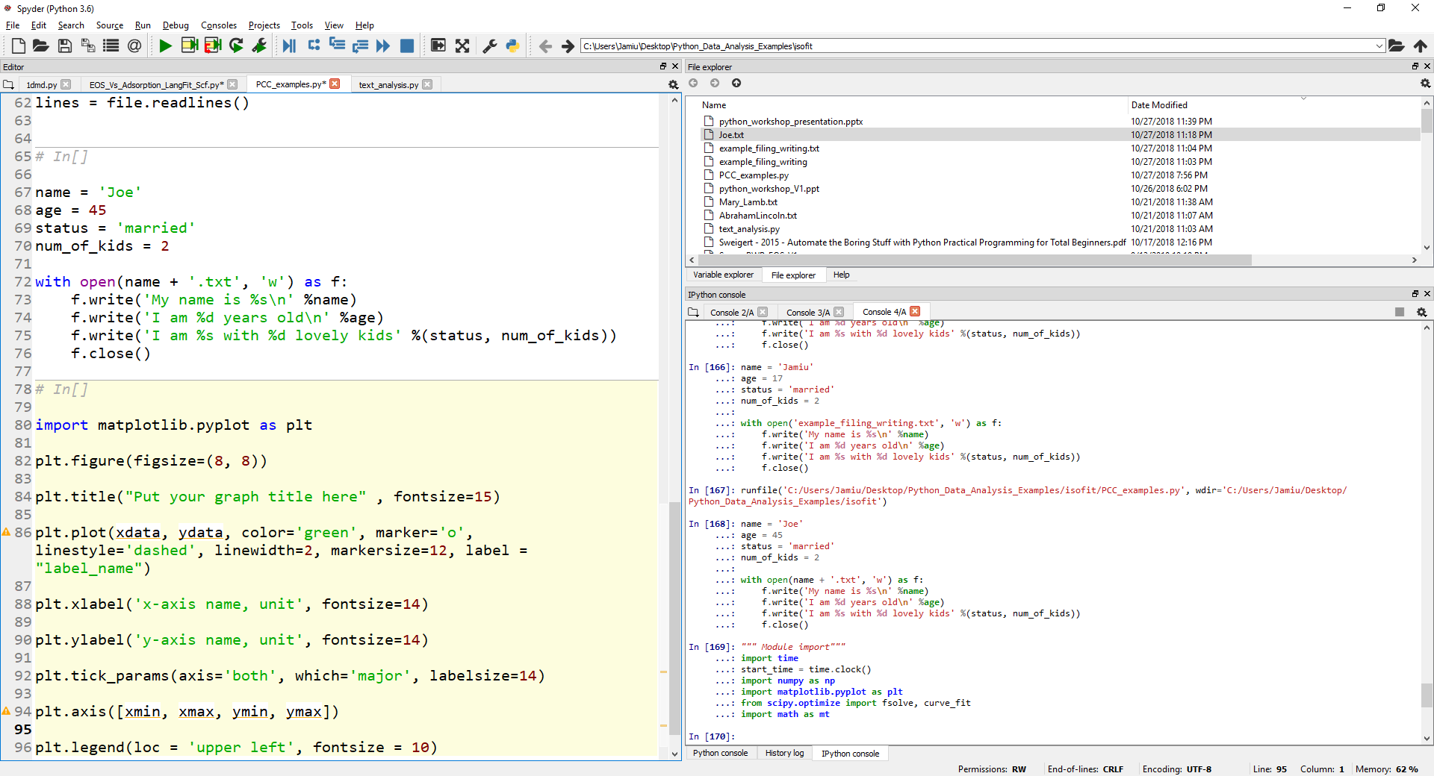
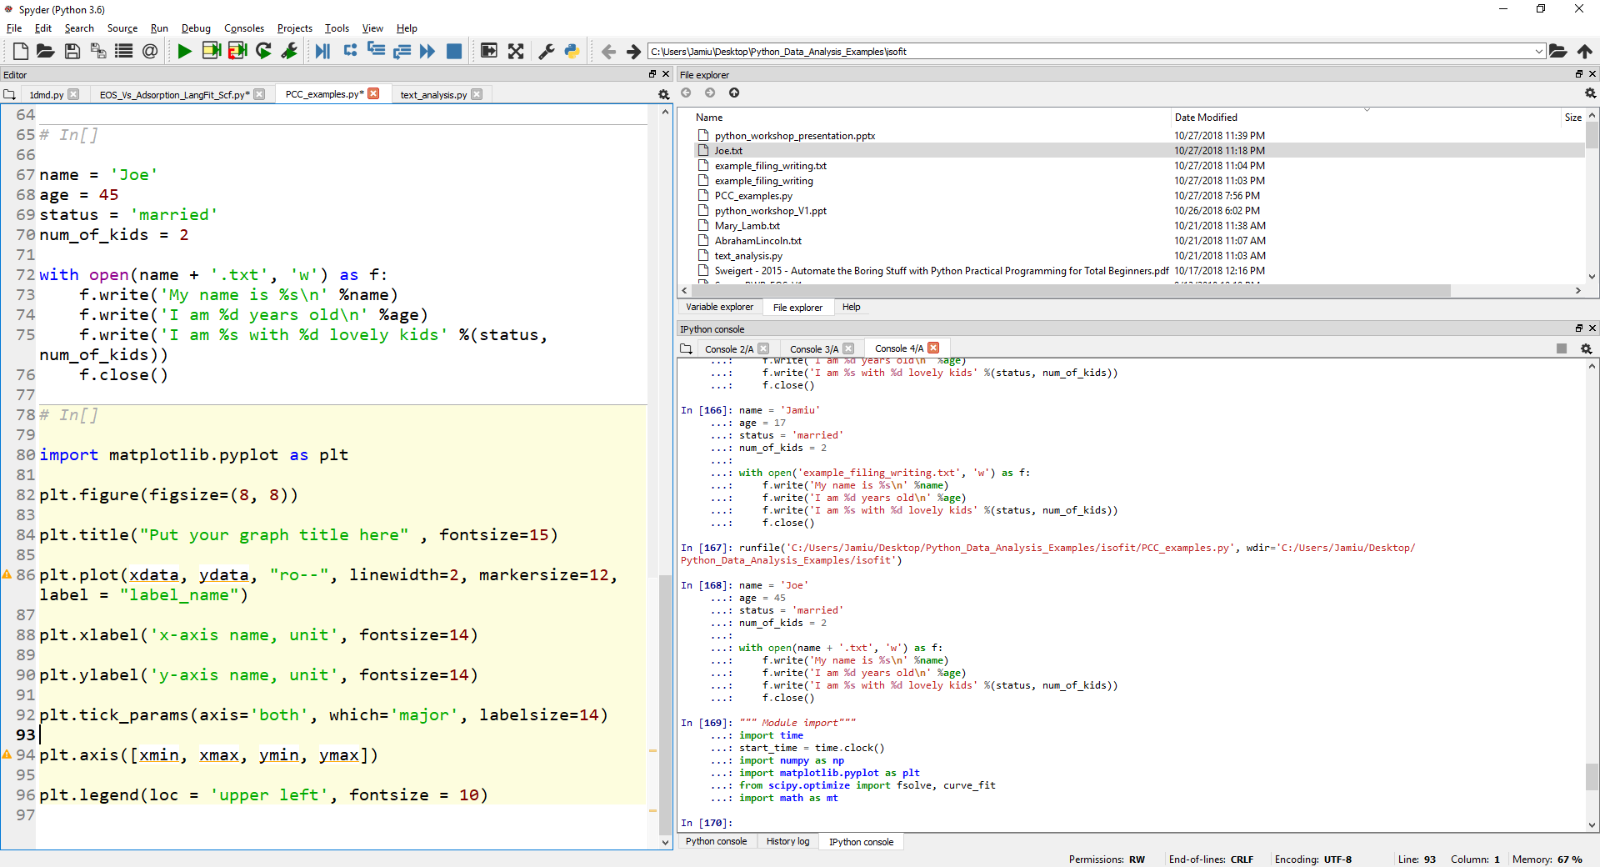
Plotting
Python Crash Course: Session 1 – overview & python basics

Slide 29
Plotting
Abbreviation | color
'b' | blue
'g' | green
'r' | red
'c' | cyan
'm' | magenta
'y' | yellow
'k' | black
'w' | white
Marker options | description
'.' | point marker
',' | pixel marker
'o' | circle marker
'v' | triangle_down marker
'^' | triangle_up marker
'<' | triangle_left marker
'>' | triangle_right marker
'1' | tri_down marker
'2' | tri_up marker
'3' | tri_left marker
'4' | tri_right marker
's' | square marker
'p' | pentagon marker
'*' | star marker
'h' | hexagon1 marker
'H' | hexagon2 marker
'+' | plus marker
'x' | x marker
'D' | diamond marker
'd' | thin_diamond marker
'|' | vline marker
'_' | hline marker
Line Options | description
'-' | solid line style
'--' | dashed line style
'-.' | dash-dot line style
':' | dotted line style
Python Crash Course: Session 1 – overview & python basics

Slide 30
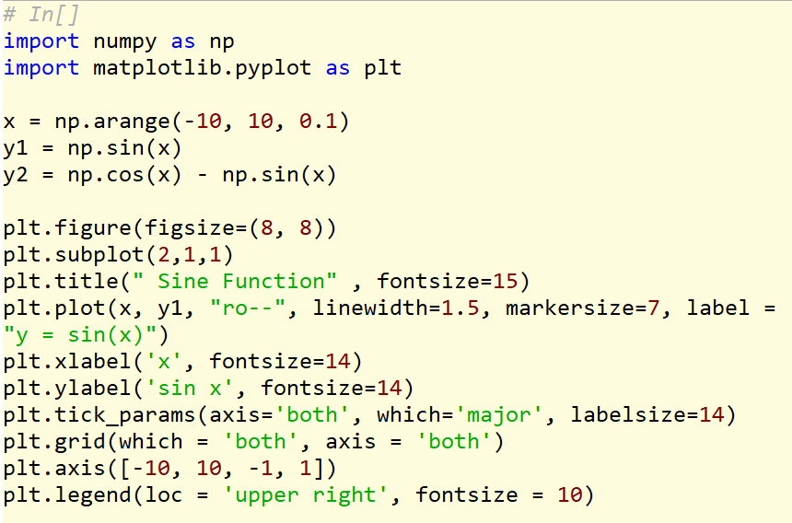
Plotting
Python Crash Course: Session 1 – overview & python basics

Slide 31
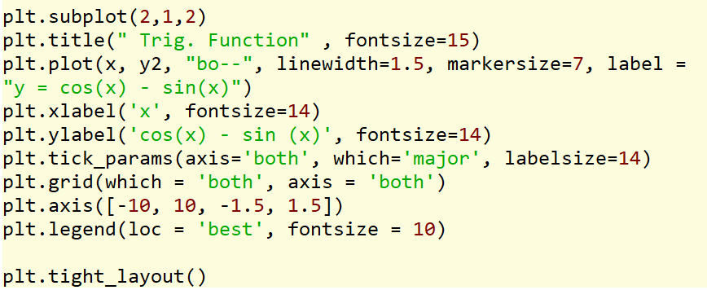
Plotting
Python Crash Course: Session 1 – overview & python basics

Slide 32
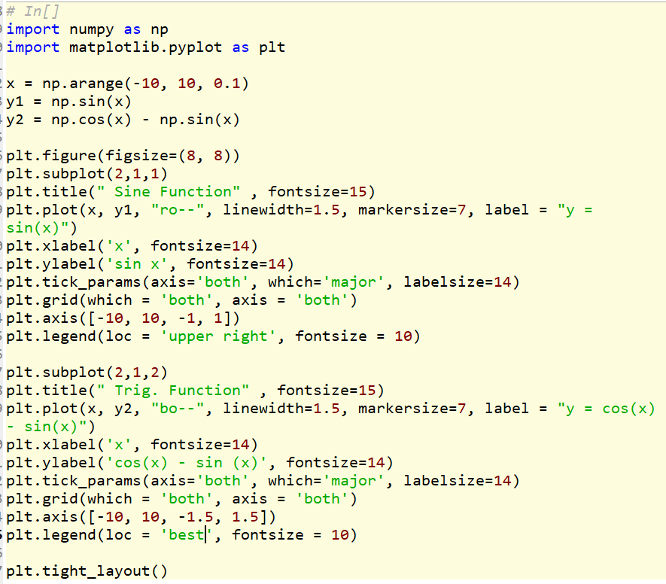
Plotting
Python Crash Course: Session 1 – overview & python basics

Slide 33
Session 2
Project 1

Slide 34
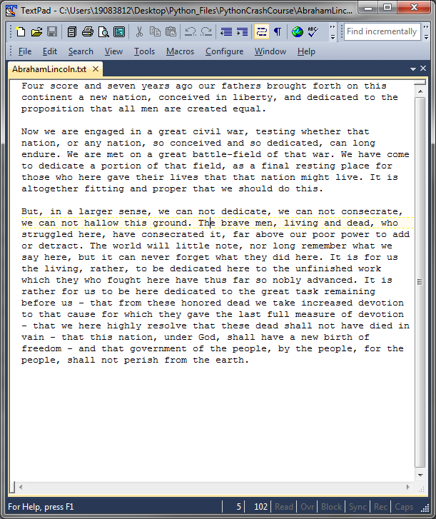
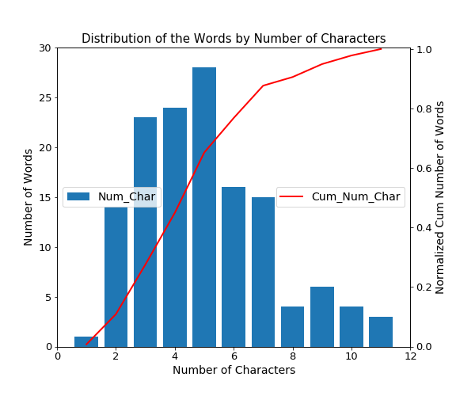
Python Data-Types, in-built functions and Variables
Aim: To consolidate the understanding of python basics and demonstrate how to:
Apply python in-built functions
Define own functions (user-defined functions)
Visualize data and format plots
Description: Analysis of a text input – frequency and length of each word in a given text
Input file: AbrahamLincoln.txt
Python Crash Course: Session 2 – project 1

Slide 35
Session 3
Data Exploration & Modelling

Slide 36
Data Exploration and Modelling (NumPy, Pandas, SciPy)
NumPy
NumPy provides n-dimensional arrays (of floats) for numerical computing
Matrices can be easily built and manipulated with NumPy
Like other modules, NumPy must be imported prior to first usage (import numpy as np)
To build a numpy array (following the import as np), simply type
my_array = np.array([element1, element2, element3, … ,last_element]) or
my_array = np.array(my_num_list)
my_array = np.array([[1, 2, 3], [4, 5, 6], [7, 8, 9]]) => 3 x 3 array
You can examine the number of elements and shape of an array using array_name.size and array_name.shape respectively
You can reshape an array to form a new array as follows:
my_new_array = my_array.reshape(shape)
(Note that shape is a tuple with 2 elements (nrows, ncols))
Python Crash Course: Session 3 – Data Exploration & Modelling

Slide 37
Data Exploration and Modelling
Some useful NumPy (array) methods
Function | Description
array(object) | Create an array.
asarray(a) | Convert the input to an array.
copy(a) | Return an array copy of the given object.
empty(shape) | Return a new array of given shape and type, without initializing entries.
empty_like(a) | Return a new array with the same shape and type as a given array.
eye(n) | Return a N-D array with ones on the diagonal and zeros elsewhere.
identity(n) | Return the identity array.
ones(shape) | Return a new array of given shape and type, filled with ones.
ones_like(a) | Return an array of ones with the same shape and type as a given array.
zeros(shape) | Return a new array of given shape and type, filled with zeros.
zeros_like(a) | Return an array of zeros with the same shape and type as a given array.
full(shape, fill_value) | Return a new array of given shape and type, filled with fill_value.
full_like(a, fill_value) | Return a full array with the same shape and type as a given array.
arraytolist(a) | Converts an array to a list object
arange(start, stop, interval) | Returns an array of evenly spaced values within a given interval
linspace(start, stop, n) | Returns an array of n numbers from start to stop
logspace(start, stop, n) | Return an array of n numbers spaced evenly on a log scale.
(Adapted from: https://docs.scipy.org/doc/numpy-1.13.0/reference/routines.array-creation.html)
Python Crash Course: Session 3 – Data Exploration & Modelling

Slide 38
Data Exploration and Modelling
NumPy Matrices: While most numerical operations involve matrices can be done with arrays (for speed), np.arrays are not matrices although they can be converted to matrices (and vice versa)
NumPy matrices are formed using the np.matrix( ) function as follows
my_matrix = np.matrix(my_array)
Selected Matrix Operations
Consider two matrices:
A = np.matrix(([1, 0, -1], [2, 1, 0], [-1, 2, 1]))
B = np.matrix(([2, -1, 1], [1, 0, 0], [2, 0, 1]))
We simply can compute
A + B
A – B
A.transpose (or A.T)
A * B
A.dot(B)
Compare you answers is 4 & 5, are they the same?
Python Crash Course: Session 3 – Data Exploration & Modelling

Slide 39
Data Exploration and Modelling
Now, let’s consider:
C = np.array([[1, 0, -1], [2, 1, 0], [-1, 2, 1]])
D = np.array(([2, -1, 1], [1, 0, 0], [2, 0, 1]))
Then try:
C * D
C.dot(D)
This is known as array broadcasting
Most operations with arrays are performed element by element. If you need matrix operations, it is safer to work with matrices and not arrays.
C * D is element by element multiplication compared C.dot(D) that is matrix multiplication
Python Crash Course: Session 3 – Data Exploration & Modelling

Slide 40
Data Exploration and Modelling
Array Slicing
Similar to list and string slicing/indexing, numpy arrays can also be sliced
General syntax for slicing an array is
array_name[row_start:row_stop, col_start:col_stop]
Remember python indexing starts from “zero”
To illustrate, consider an array: A1 = np.array(range(15)).reshape((3,5))
Try the following and examine the results (wrt array A1):
A1[:]
A1[0:2]
A1[:, 0:2]
A1[:, 2]
A1[1:2, 1:2]
A1[1:2:, 1:2]
A1[2,:]
A1[:, -1]
Python Crash Course: Session 3 – Data Exploration & Modelling

Slide 41
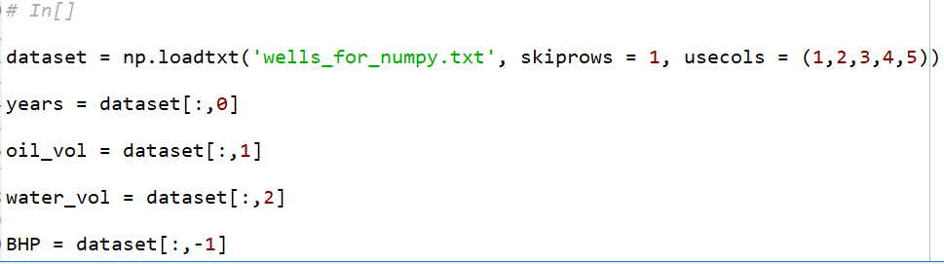
Data Exploration and Modelling
Reading structured data from a file using NumPy
Structured data (floats) can be read into python as numpy arrays using the np.loadtxt( ) function as follows:
data_in = np.loadtxt(filename, delimiter = None, skiprows = 0, usecols = None)
File usually should be any file format readable with a text editor
For example:
Python Crash Course: Session 3 – Data Exploration & Modelling

Slide 42
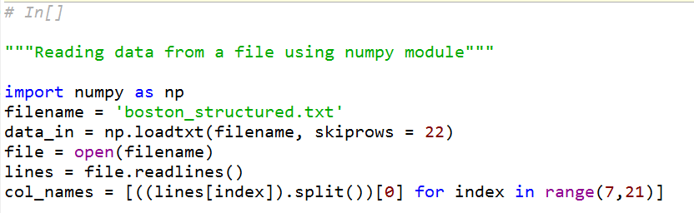
Data Exploration and Modelling
Open the dataset named “boston_structured.txt” with any text editor and examine the contents
Now, let’s open the file with numpy.loadtxt( ) and use open( ) & readlines( ) functions to get the column names – this will be particularly useful in log data analysis
Python Crash Course: Session 3 – Data Exploration & Modelling

Slide 43
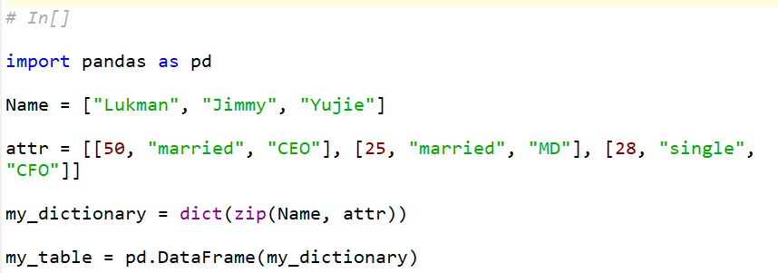
Data Exploration and Modelling (NumPy, Pandas, SciPy)
Pandas
Pandas is useful for manipulating numerical tables and time series data
It can be used to create tables using the DataFrame function. This is especially useful for generating data for use in Excel
Like other modules, pandas must be imported prior to first use
Example:
Python Crash Course: Session 3 – Data Exploration & Modelling

Slide 44
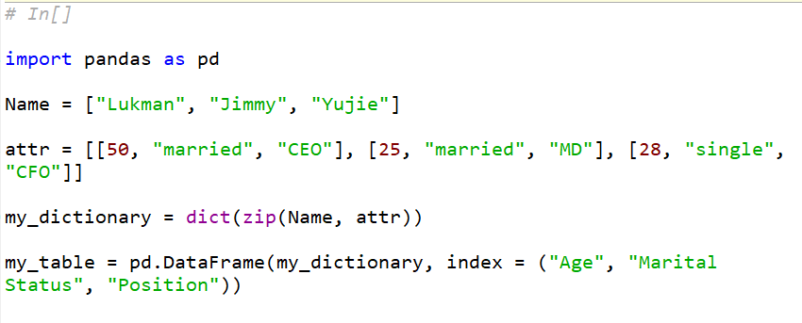
Data Exploration and Modelling (NumPy, Pandas, SciPy)
The index can be changed to any entry. For example:
Python Crash Course: Session 3 – Data Exploration & Modelling

Slide 45
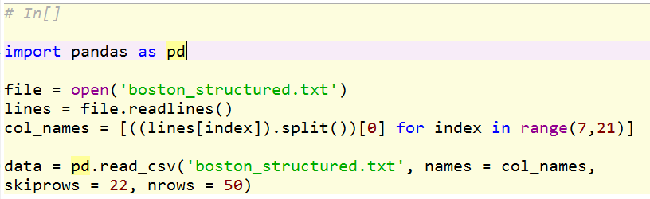
Data Exploration and Modelling (NumPy, Pandas, SciPy)
To read data from files using pandas: csv files, tables, excel files, json, html, SAS, SQL, etc.
Now, try type data in your console. What can you see?
pandas.read_csv(filepath_or_buffer, sep=', ', header='infer', names=None, index_col=None, usecols=None, skipinitialspace=False, skiprows=None, nrows=None, na_values=None, na_filter=True, skip_blank_lines=True, parse_dates=False, infer_datetime_format=False, keep_date_col=False, thousands=None, skipfooter=0, delim_whitespace=False)
Python Crash Course: Session 3 – Data Exploration & Modelling

Slide 46
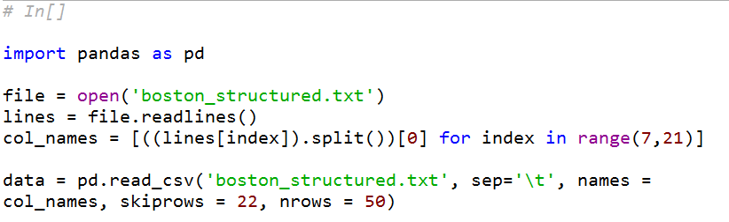
Data Exploration and Modelling (NumPy, Pandas, SciPy)
Again, try type data in your console. Any difference?
Python Crash Course: Session 3 – Data Exploration & Modelling

Slide 47
Data Exploration and Modelling (NumPy, Pandas, SciPy)
Again, try type data in your console. Any difference?
Python Crash Course: Session 3 – Data Exploration & Modelling

Slide 48
Data Exploration and Modelling (NumPy, Pandas, SciPy)
Now, let’s explore the data
Try:
data.head( )
data.tail( )
data.CRIM
par = np.min(data.CRIM)*data.B
new_array = data.NOX[:-1:2]
Python Crash Course: Session 3 – Data Exploration & Modelling

Slide 49
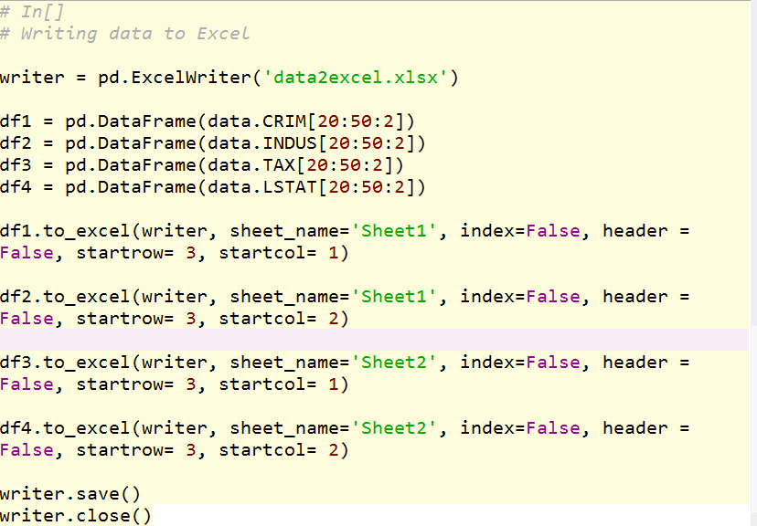
Data Exploration and Modelling (NumPy, Pandas, SciPy)
The pandas.ExcelWriter( ) function is used to convert DataFrames to Excel files
Python Crash Course: Session 3 – Data Exploration & Modelling

Slide 50
Data Exploration and Modelling
SciPy
SciPy is the scientific computing module in python. It is built from different python modules (most significant NumPy)
SciPy can be used to solve linear and non-linear problems, perform optimization, statistical analysis, curve-fitting & parameter estimation, etc.
To illustrate some of SciPy’s capabilities, let’s do the following:
Data interpolation
Open the files named “GCMC_Kernels.txt” & “expt_isotherm.txt” as numpy arrays and parameterize columns
Generate kernels for the relative pressure values in the expt_isotherm.txt file
Normal distribution fit
Generate an array using np.linspace()
Fit the array to normal distribution
Python Crash Course: Session 3 – Data Exploration & Modelling

Slide 51
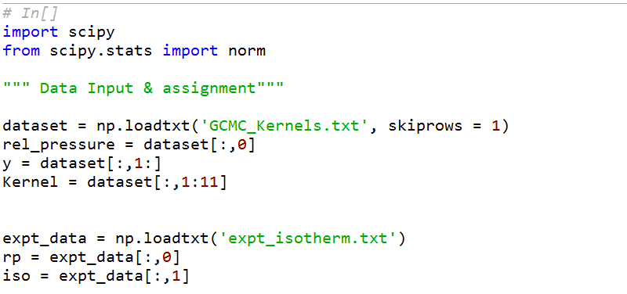
Data Exploration and Modelling
Python Crash Course: Session 3 – Data Exploration & Modelling

Slide 52
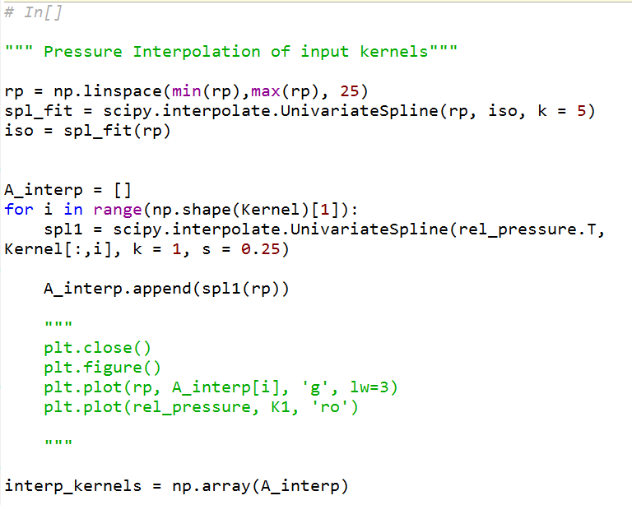
Data Exploration and Modelling
Python Crash Course: Session 3 – Data Exploration & Modelling

Slide 53
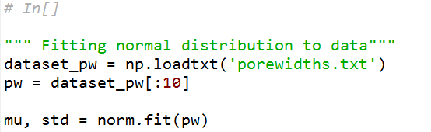
Data Exploration and Modelling
Python Crash Course: Session 3 – Data Exploration & Modelling

Slide 54
Session 4
Project 2

Slide 55
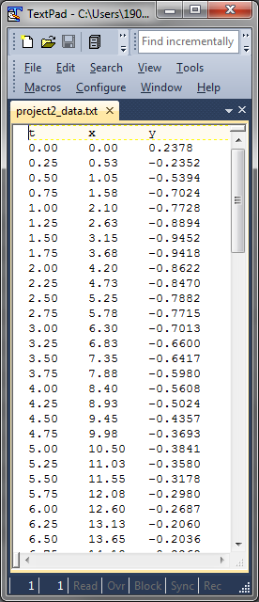
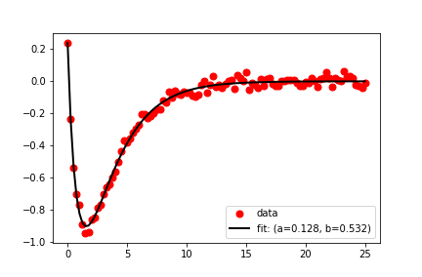
Project 2 – Curve-Fitting & Parameter Estimation
Aim: To apply the concepts learnt to a scientific dataset.
Apply python in-built functions (mostly string operations)
Define own functions (user-defined functions)
Visualize data and format plots
Description: Apply the curve-fitting module of SciPy to fit a dataset to a given model and estimate the optimal values & standard deviations of the fitting parameters
Input file: project2_data.txt
model = func(xdata, a, b)
Model parameters
Python Crash Course: Session 4 – Project 2

Slide 56
References
https://www.w3schools.com/python/default.asp
https://docs.scipy.org/doc/scipy-0.18.1/reference/
https://www.learnpython.org/en/Basic_String_Operations
https://python-3-patterns-idioms-test.readthedocs.io/en/latest/Comprehensions.html
https://matplotlib.org/api/_as_gen/matplotlib.pyplot.plot.html
https://docs.scipy.org/doc/numpy-1.13.0/reference/routines.array-creation.html

